Slide 1
Generative Adversarial Networks for Time Series
Autonomous Multisensor Systems Group
Institute for Intelligent Cooperating Systems
Faculty of Computer Science
Otto von Guericke University, Magdeburg
16.05.2024
Team Members: Archana Yadav, Gowtham Premkumar, Shweta Bambal

Slide 2
Contents
Introduction
Related Work
Existing Implementations and Dataset

Slide 3
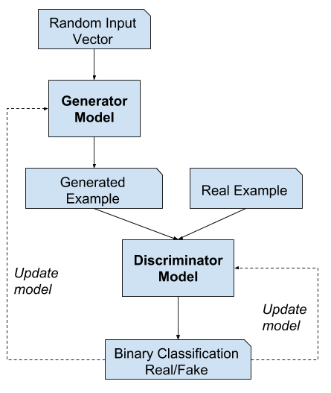
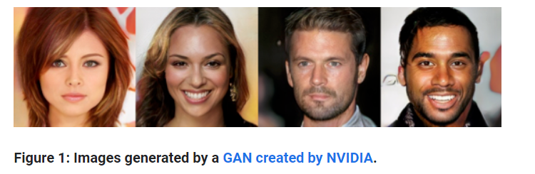
Introduction
Generative Adversarial Networks (GANs) are made up of two neural networks, a discriminator and a generator. They use adversarial training to produce artificial data that is identical to actual data.
https://machinelearningmastery.com/what-are-generative-adversarial-networks-gans/

Slide 4
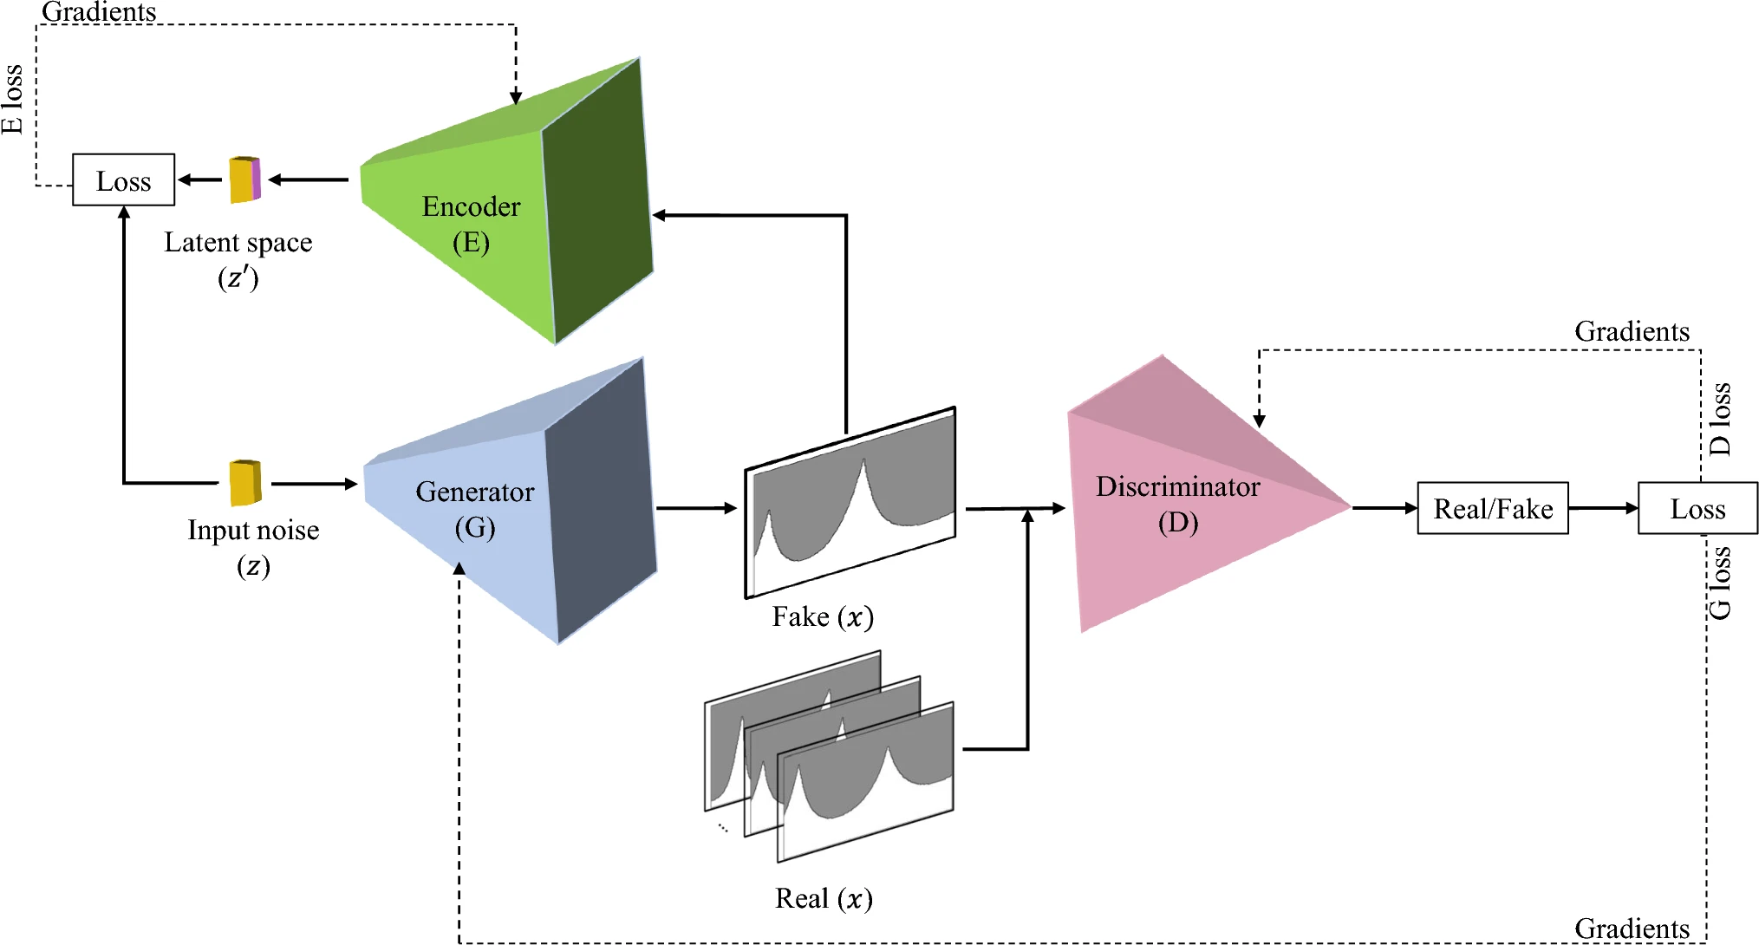
Using GAN to Predict Milling Machine Stability
Goal: Predict stability maps for milling with limited data using generative adversarial networks (EGAN).
Components:
Encoder: Compresses stability maps into a latent space representing key features.
Generator: Creates new stability maps from points in the latent space.
Discriminator: Distinguishes real vs. generated stability maps.
Modelling:
It is an anomaly detection model and is generating the stability maps of milling machine
Uses Deep Convolutional GAN architecture.
Uses Binary Cross Entropy loss functions for generator and discriminator
Uses L1 loss function (Mean Absolute Error (MAE)) for encoder
Relevance:
Can be used for sequential/time-series dataset by replacing DCGAN with RNNs like LSTM or GRU.

Slide 5
TimeGAN Implementation :
Synthetic Data Generation:
TimeGAN generates data by first embedding real data into a latent space, manipulating it, and then recovering it back to the original space, thus synthesizing new data samples.
Model Components:
Embedding Network: Converts real data to a simpler latent space.
Recovery Network: Reconstructs original-like data from latent space.
Generator: Creates new data samples in latent space.
Supervisor: Teaches the generator the temporal patterns of real data.
Discriminator: Identifies if data is real or synthetic, ensuring realism.
Network Structure:
Uses RNNs like GRU or LSTM, ideal for sequential data.
Loss Functions:
Supervised Loss: Matches generated data's time patterns with real data.
Adversarial Loss: Makes synthetic data indistinguishable from real.
Moment Matching Loss: Ensures statistical alignment between real and generated data.
https://github.com/jsyoon0823/TimeGAN?tab=readme-ov-file

Slide 6
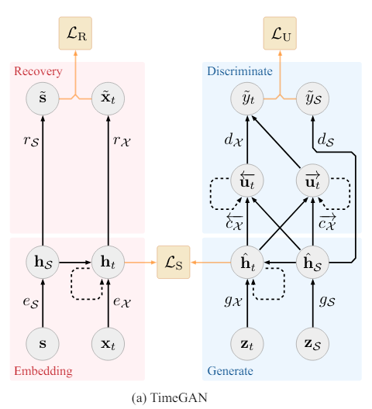

Slide 7
Sample Dataset 1:
Dataset analysis for the power consumption of a programmable CNC milling machine with the process features.
Data columns (total 17 columns):
# Column Non-Null Count Dtype
--- ------ -------------- -----
0 start_time 220 non-null int64
1 end_time 220 non-null int64
2 processing_time 220 non-null int64
3 average_power_consumption 220 non-null int64
4 number_of_missing_datapoints 220 non-null int64
5 raw_volume 220 non-null int64
6 number_of_lines_of_code 220 non-null int64
7 number_tool_changes 220 non-null int64
8 number_of_travels_to_machine_zero_point_in_rapid_traverse 220 non-null int64
9 number_axis_rotations 220 non-null int64
10 weighted_speed 220 non-null int64
11 weighted_tool_diameter 220 non-null int64
12 weighted_cutting_length 220 non-null int64
13 weighted_number_of_cutting_edges 220 non-null int64
14 weighted_cutting_speed 220 non-null int64
15 weighted_feed_per_tooth 220 non-null int64
16 weighted_feedrate 220 non-null int64

Slide 8
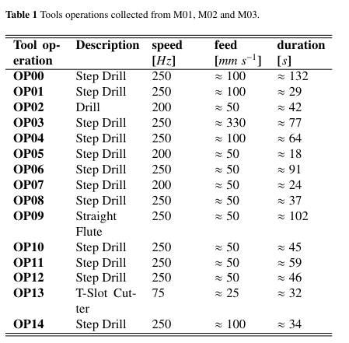
Sample Dataset 2:
The dataset provided is a collection of real-world industrial vibration data collected from a brownfield CNC milling machine.
The X- Y- and Z-axes of the accelerometer have been recorded using a sampling rate equal to 2 kHz
Data is from three different CNC milling machines each executing 15 processes.

Slide 9
References
https://github.com/subashpal4/CNC_MillingMachine_Production_-DataSet_Analysis
https://github.com/boschresearch/CNC_Machining/tree/main/data
https://github.com/jsyoon0823/TimeGAN?tab=readme-ov-file
https://papers.nips.cc/paper_files/paper/2019/hash/c9efe5f26cd17ba6216bbe2a7d26d490-Abstract.html
https://github.com/ShahrbanooRezaei/GANs-to-predict-stability-maps-in-milling-machining/tree/main/data
Rezaei, S., Cornelius, A., Karandikar, J. et al. Using GANs to predict milling stability from limited data. J Intell Manuf (2024). https://doi.org/10.1007/s10845-023-02291-1
https://www.kaggle.com/code/carlkirstein/predictive-maintenance-milling-machine-98-6/notebook
https://www.kaggle.com/datasets/vinayak123tyagi/milling-data-set-prognostic-data

Slide 10
Generative Adversarial Networks for Time Series
Thank You For Your Attention!

